Slide 1
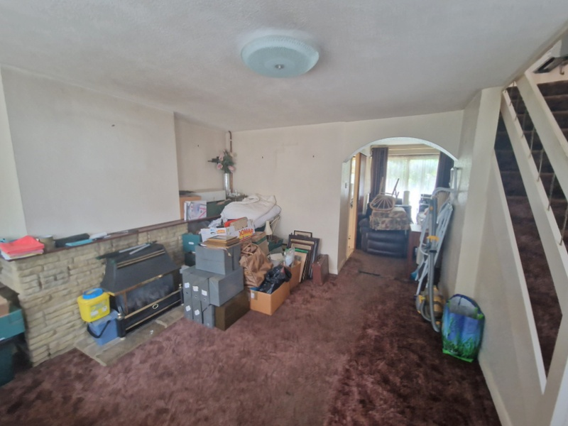
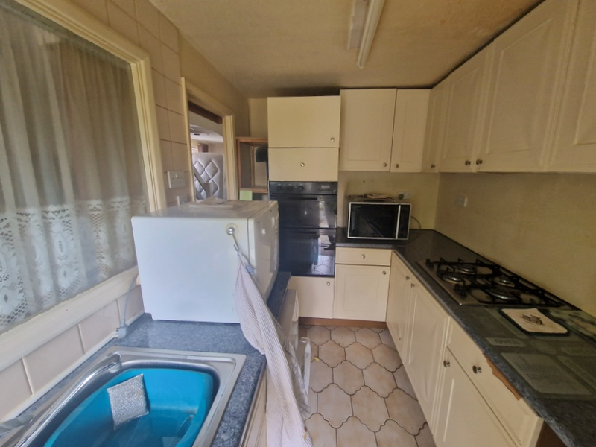
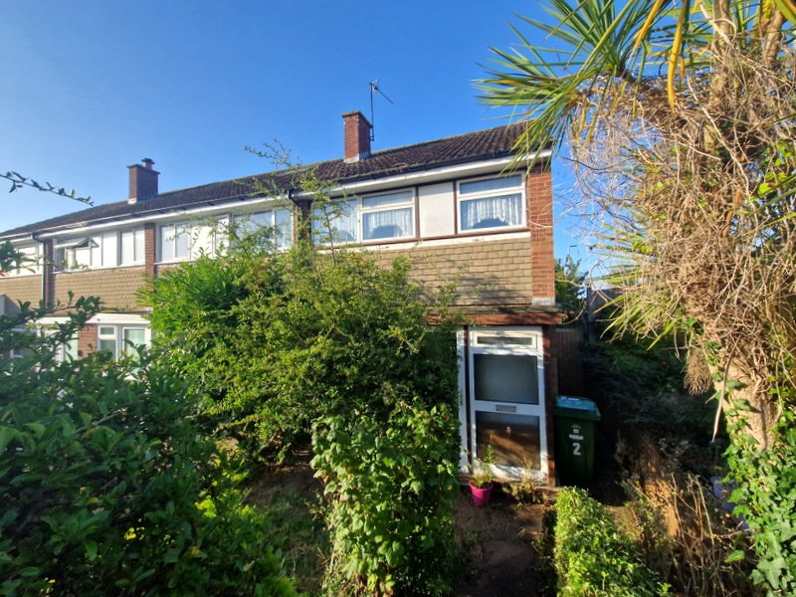
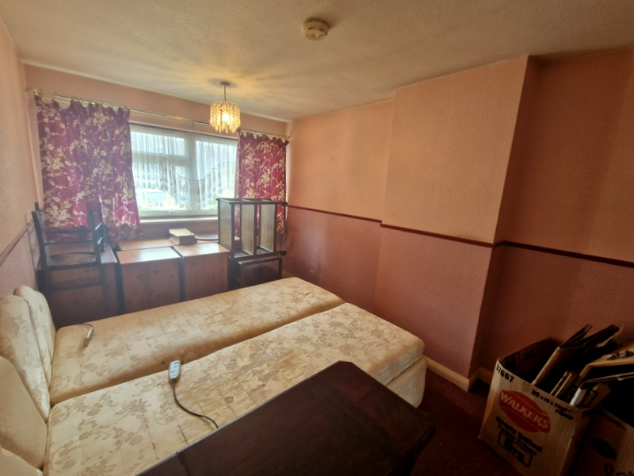
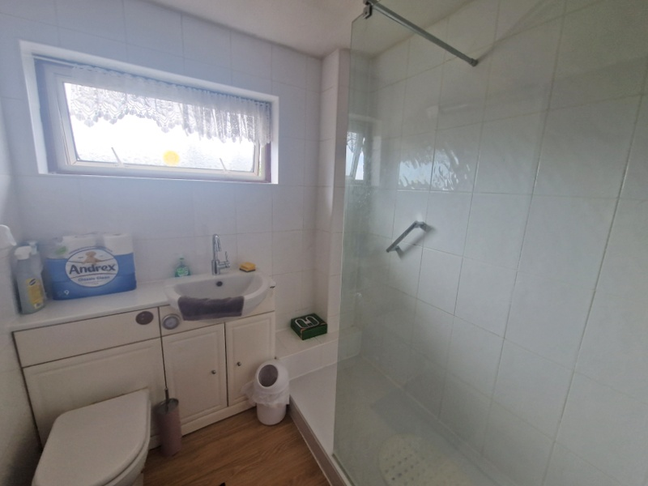
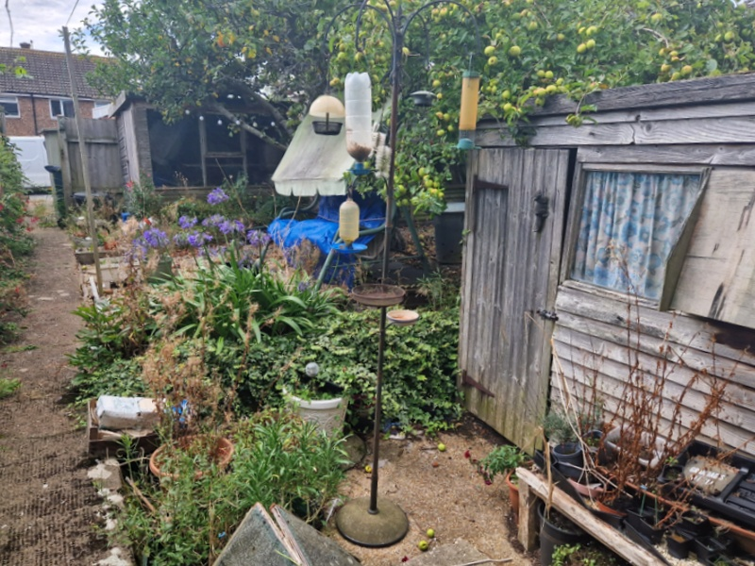
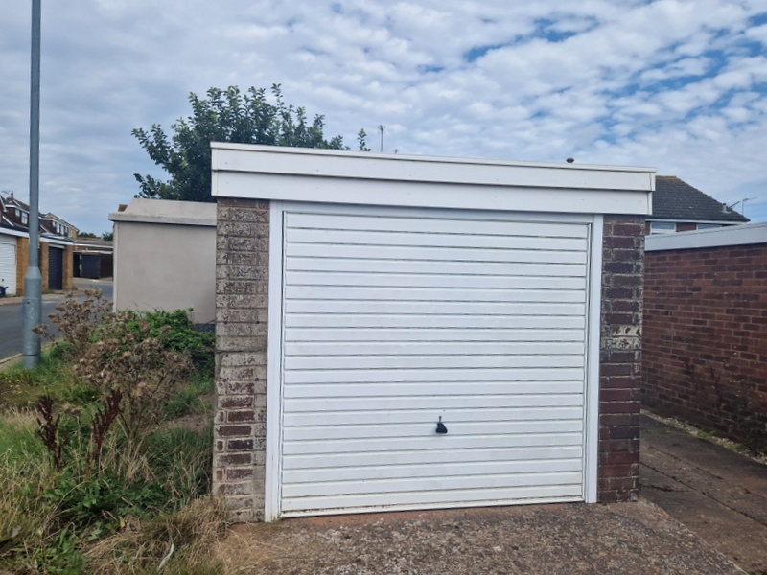
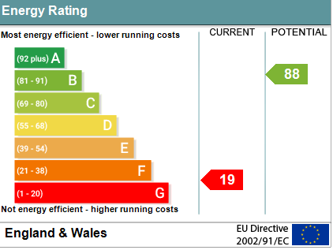
www.pennys.net
2 Martins Road, Exmouth, EX8 4LN
GUIDE PRICE £220,000
TENURE Freehold
An Opportunity To Purchase An End Of Terrace House Which Now Requires A Programme Of Modernisation And Refurbishment, With A Generously Sized Rear Garden, Garage And Parking
Entrance Porch * Lounge And Dining Area * Kitchen * Three Bedrooms Shower Room/Wc * No Ongoing Chain
Pennys Estate Agents Limited for themselves and for the vendor of this property whose agents they are give notice that:- (1) These particulars do not constitute any part of an offer or a contract. (2) All statements contained in these particulars are made without responsibility on the part of Pennys Estate Agents Limited. (3) None of the statements contained in these particulars are to be relied upon as a statement or representation of fact. (4) Any intending purchaser must satisfy himself/herself by inspection or otherwise as to the correctness of each of the statements contained in these particulars. (5) The vendor does not make or give and neither do Pennys Estate Agents Limited nor any person in their employment has any authority to make or give any representation or warranty whatever in relation to this property.
PENNYS ESTATE AGENTS
2 Rolle House, Rolle Street, Exmouth, Devon, EX8 2SN
Tel: 01395 264111 EMail: help@pennys.net

Slide 2
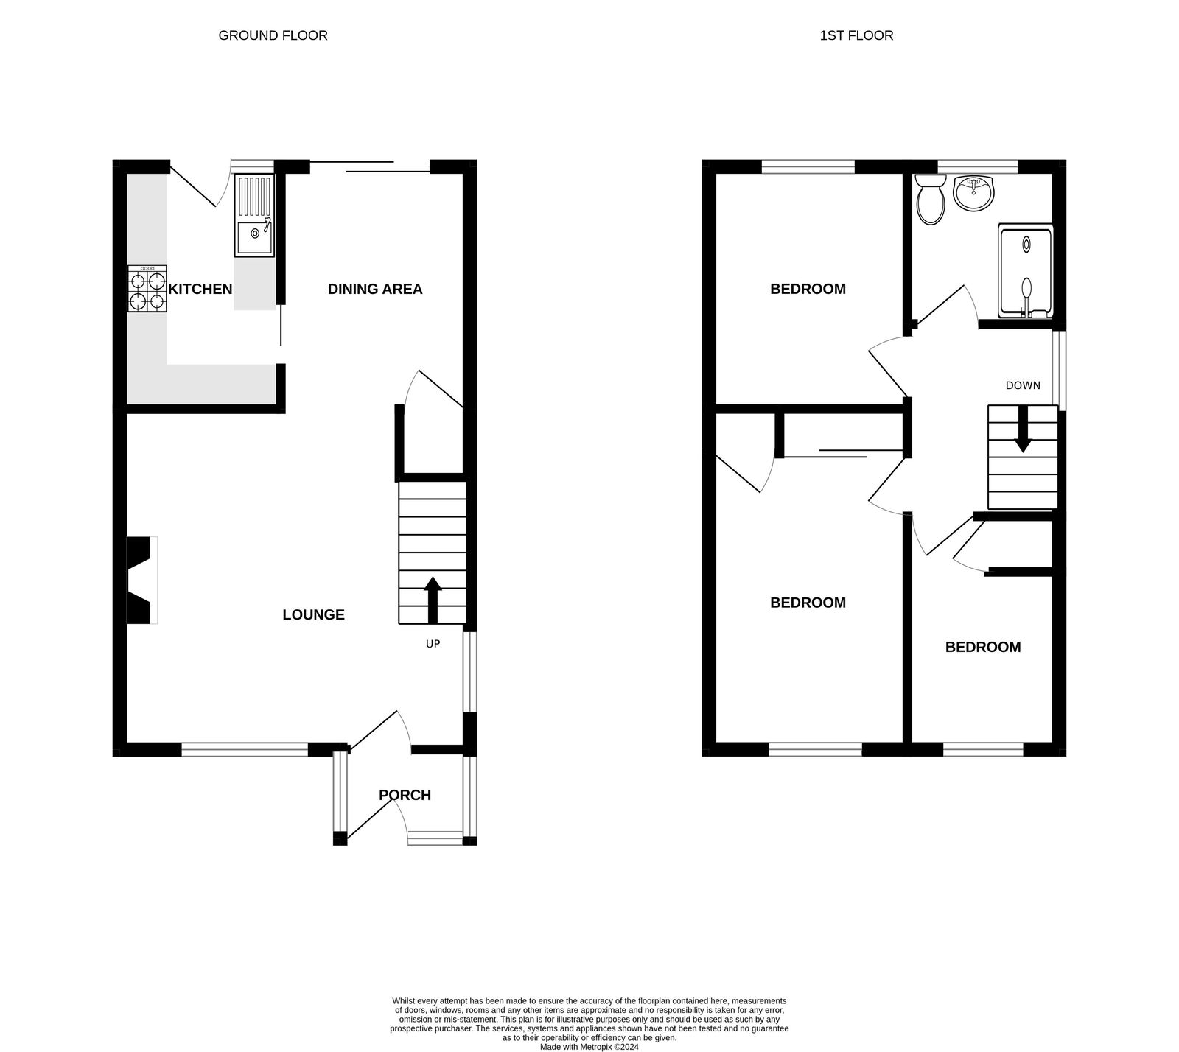
2 Martins Road, Exmouth, EX8 4LN
THE ACCOMMODATION COMPRISES: Double glazed front door to:
ENTRANCE PORCH: 1.83m x 1.52m (6'0" x 5'0") Inner door to:
LOUNGE/DINING ROOM:
LOUNGE AREA: 4.52m x 4.42m (14'10" x 14'6") Feature stone fireplace with display surfaces with fitted gas fire standing on a stone hearth, double glazed window to front and side aspects, stairs rising to first floor landing, archway to:
DINING AREA: 2.92m x 2.39m (9'7" x 7'10") With double glazed sliding doors opening onto the rear garden, understairs storage cupboard.
KITCHEN: 3.18m x 2.03m (10'5" x 6'8") Comprising of worktops with cupboards and drawer units and plumbing for automatic washing machine beneath, inset single drainer sink unit, gas hob, built-in oven, wall mounted cupboards, double glazed window and door giving access to the rear garden.
FIRST FLOOR LANDING: Double glazed window to side aspect, gas convector heater, access to roof space via loft ladder.
BEDROOM 1: 4.22m x 2.62m (13'10" x 8'7") With double glazed window to front aspect, built-in wardrobes with mirror fronted doors, airing cupboard housing water cylinder and slatted shelving.
BEDROOM 2: 2.87m x 2.51m (9'5" x 8'3") Double glazed window to rear aspect.
BEDROOM 3: 3.35m x 1.8m (11'0" x 5'11") maximum. With fitted cupboard over stairwell, double glazed window to front aspect.
SHOWER ROOM/WC: 1.85m x 1.85m (6'1" x 6'1") Fitted with double width shower cubicle with Mira shower unit, wash hand basin set in display surfaces with cupboards and WC with push button flush beneath, fully tiled walls, mirror fronted medicine cabinet, double glazed window with patterned glass.
OUTSIDE: To the front of the property is a garden area with mature shrubs with small patio terrace area adjoining the property, side pathway with raised shrub beds and gate giving access to the rear garden. The rear garden is a good size comprising of patio and decorative stone areas, two sheds, productive apple trees, pathway and rear gate giving access to GARAGE with up and over door with parking spaces to either side of the Garage.
Mortgage Assistance We are pleased to recommend Meredith Morgan Taylor, who would be pleased to help no matter which estate agent you finally buy through. For a free initial chat please contact us on 01395 264111 to arrange an appointment. Your home may be repossessed if you do not keep up repayments on your mortgage. Meredith Morgan Taylor Ltd is an appointed representative of Openwork Limited, a trading style of Openwork Ltd which is authorised and regulated by the Financial Conduct Authority (FCA) .
FLOOR PLAN:

